Slide 1
BI Analysis Week 7
Shawna Tuli (Shawna.tuli@avanade.com)

Slide 2
Agenda
Data visualization
Power bi
Tableau
excel

Slide 3
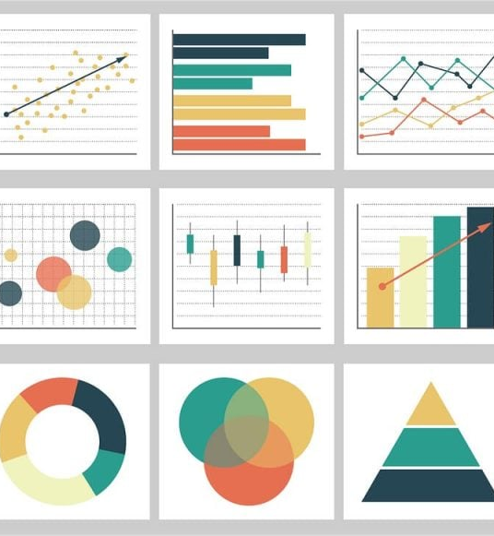
Data Visualization

Slide 4
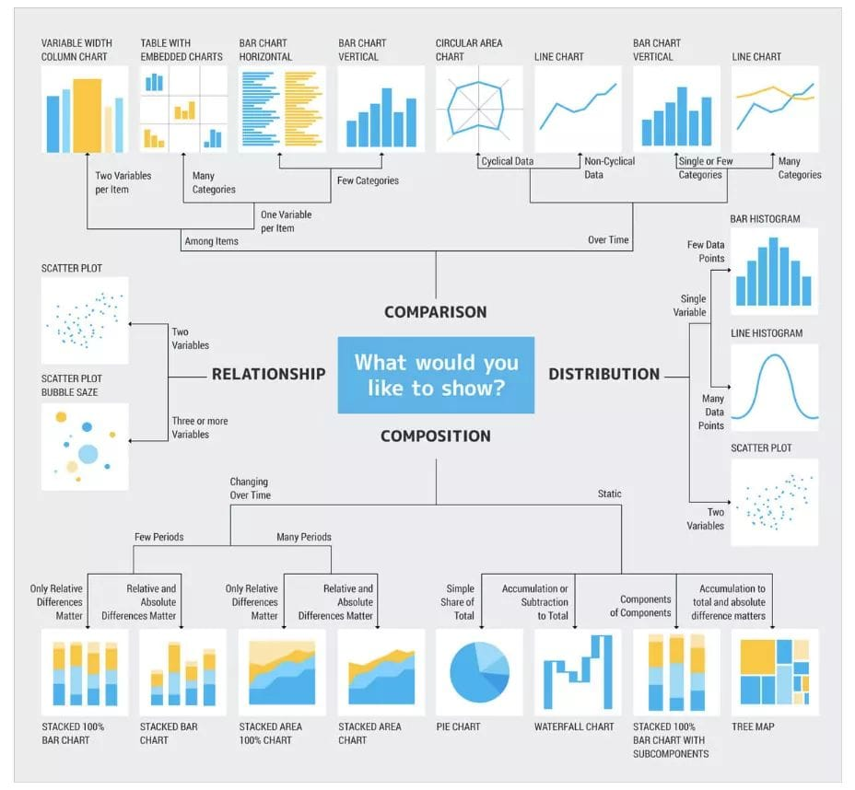

Slide 5
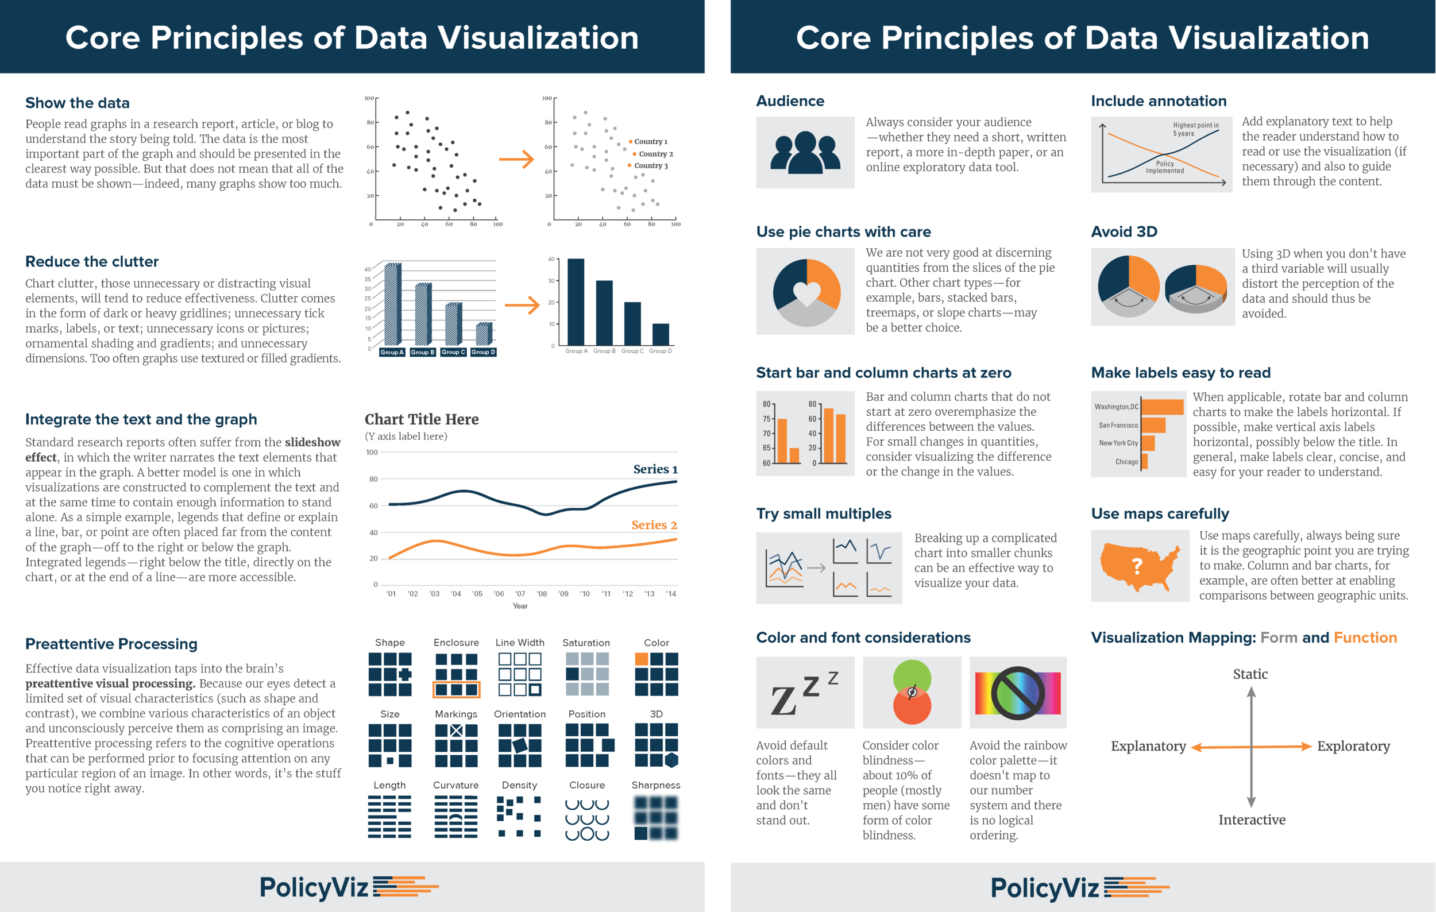

Slide 6
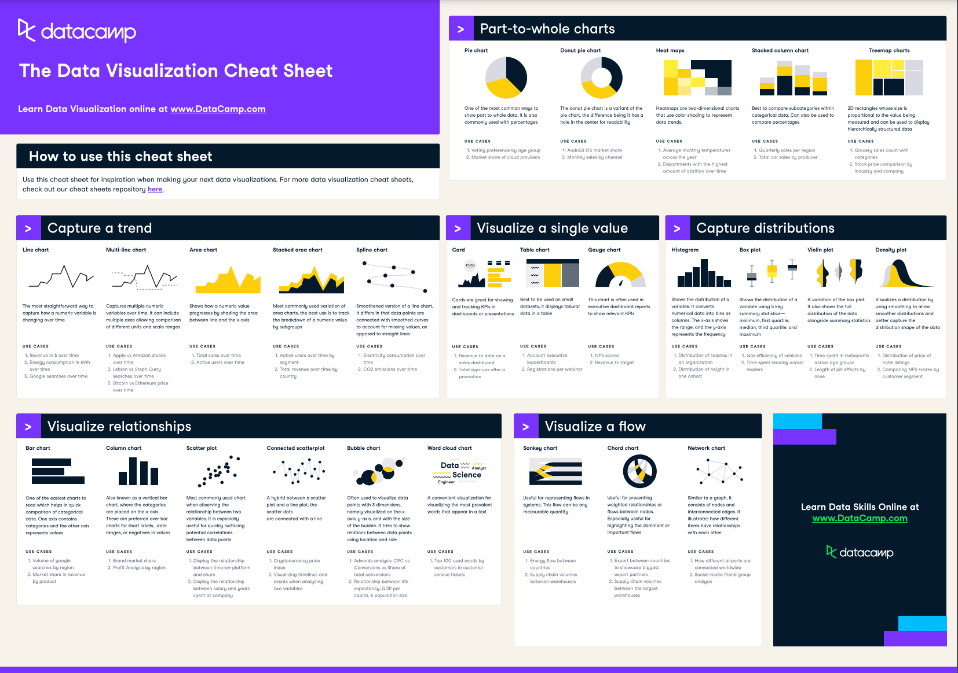

Slide 7
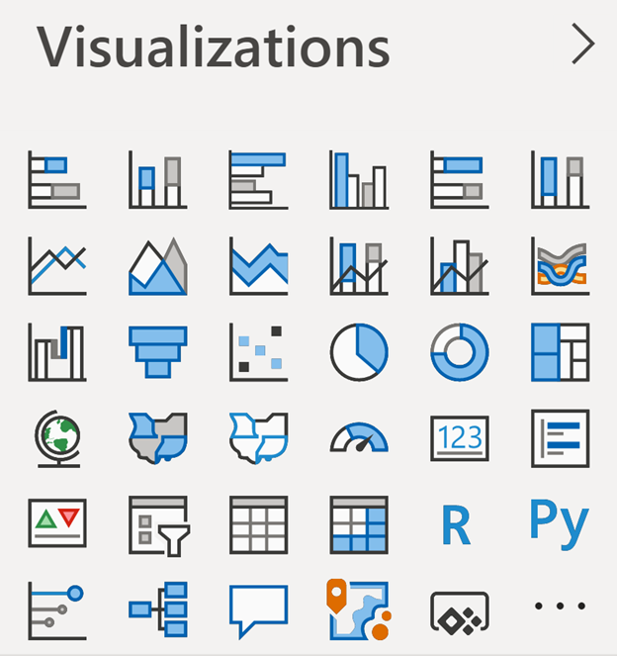
Power BI

Slide 8
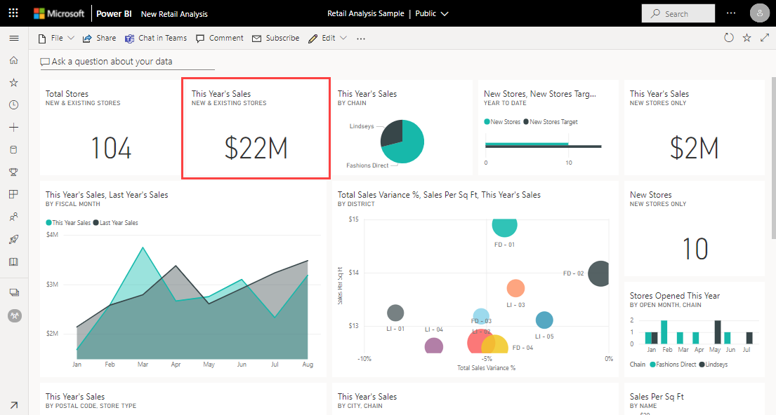

Slide 9
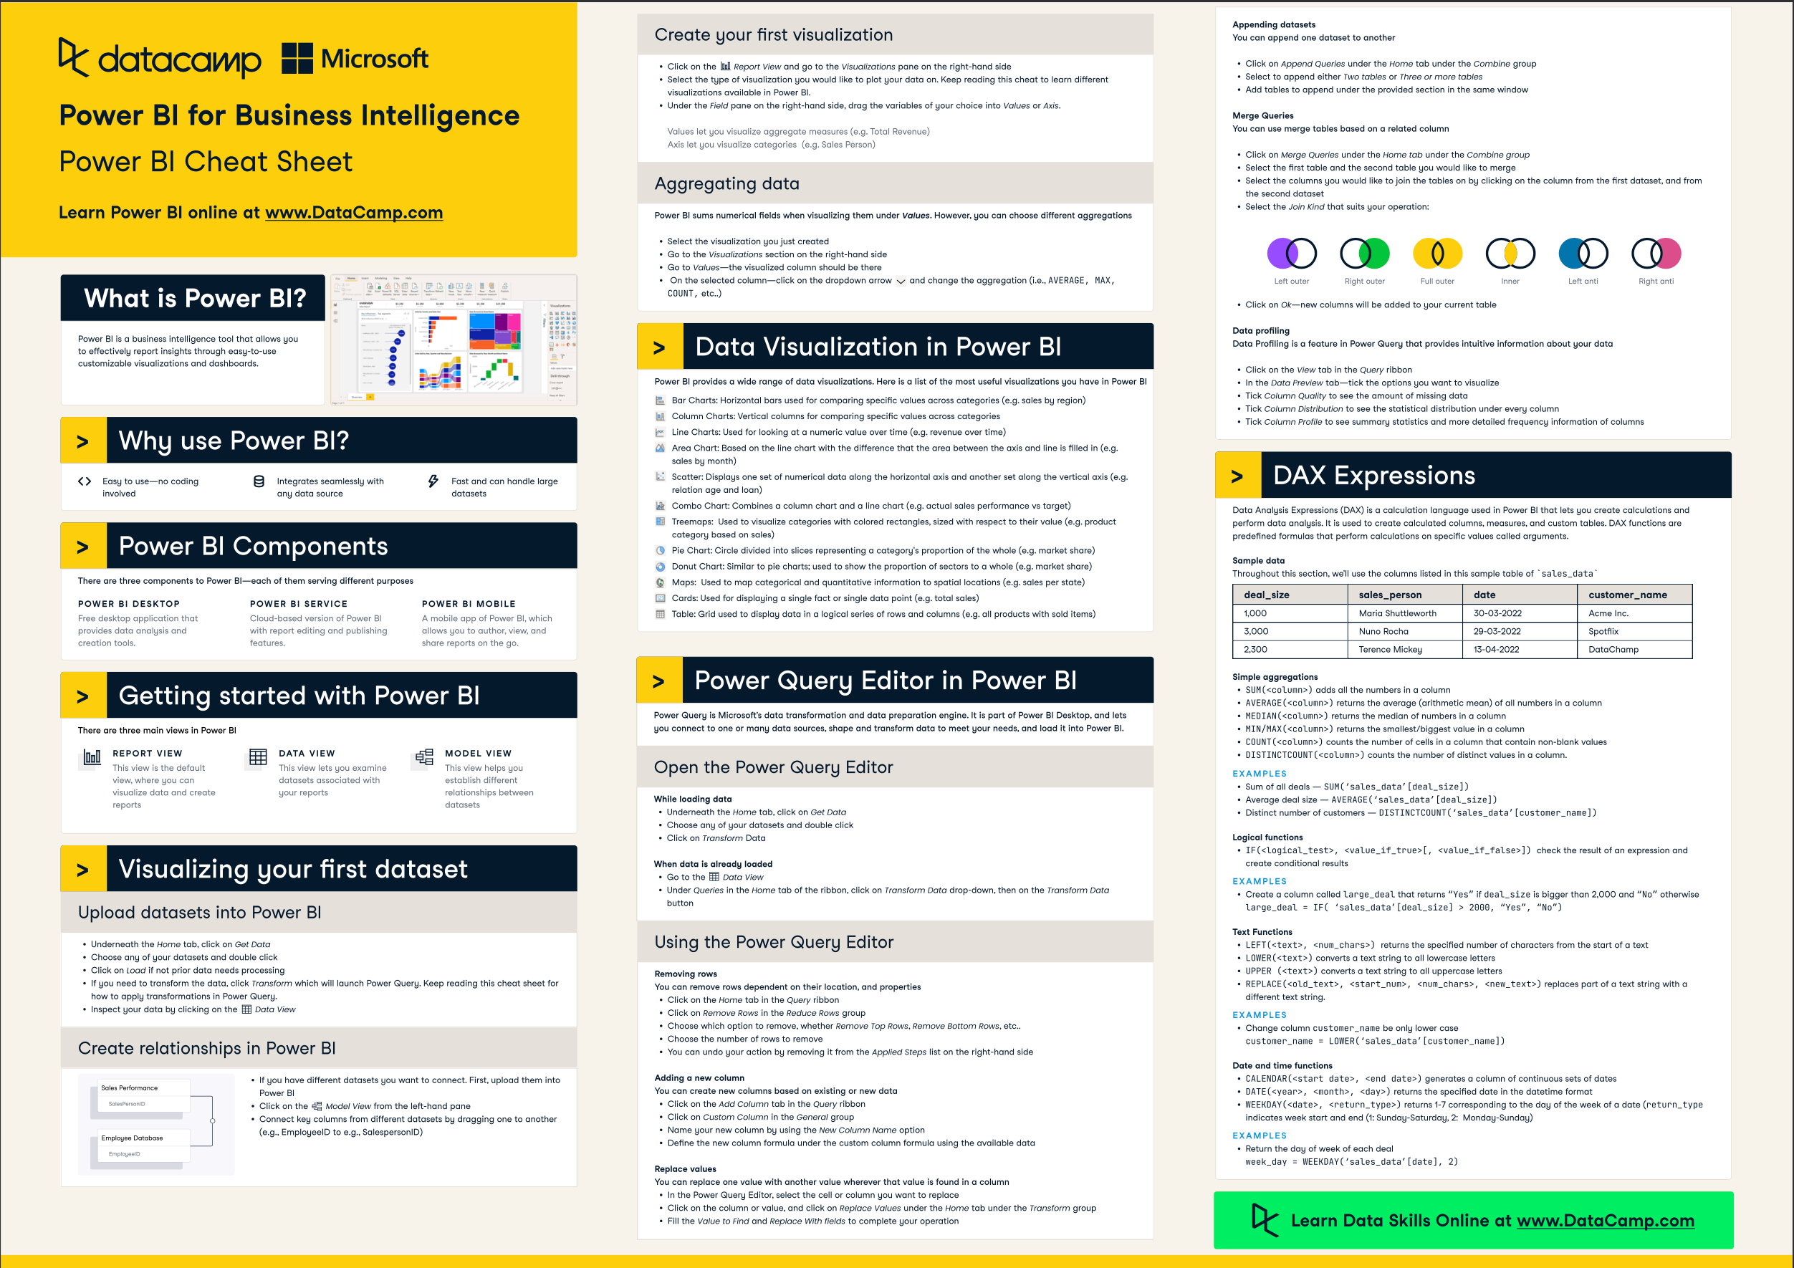

Slide 10
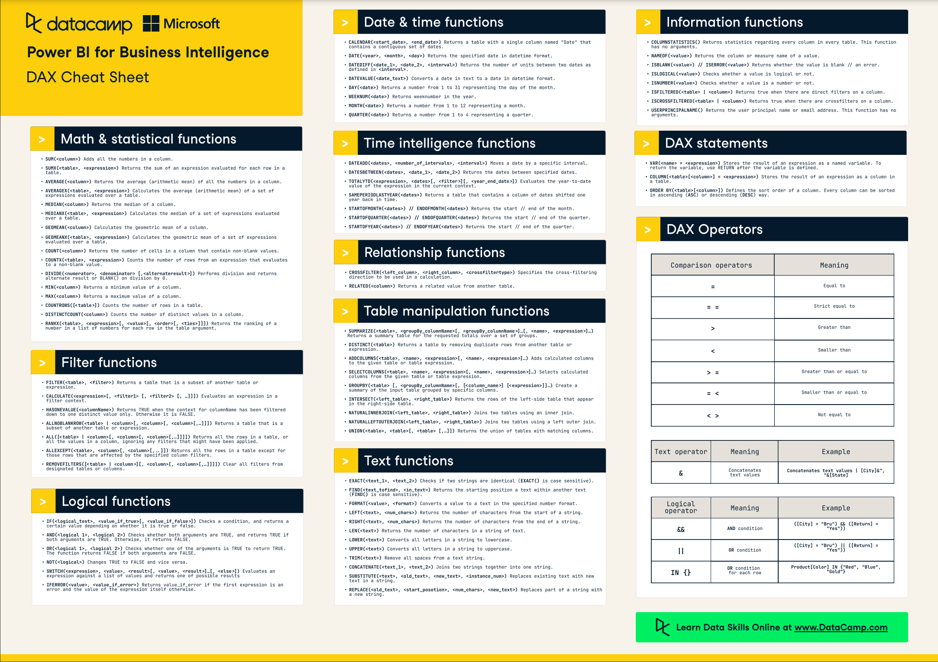

Slide 11
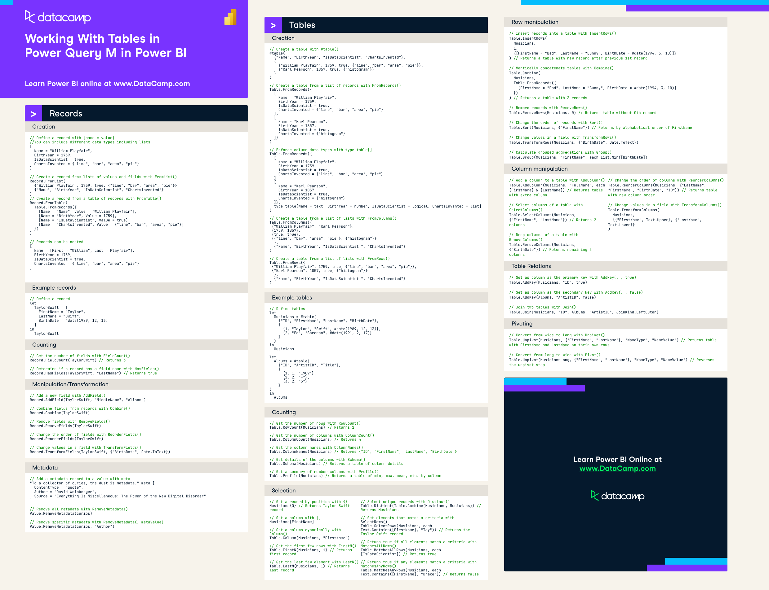

Slide 12
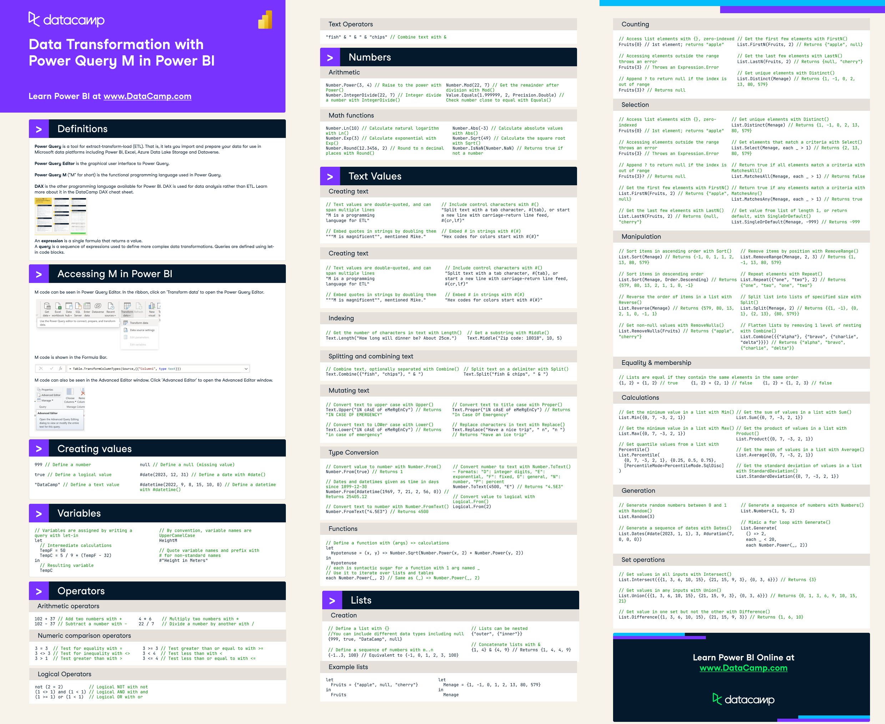

Slide 13
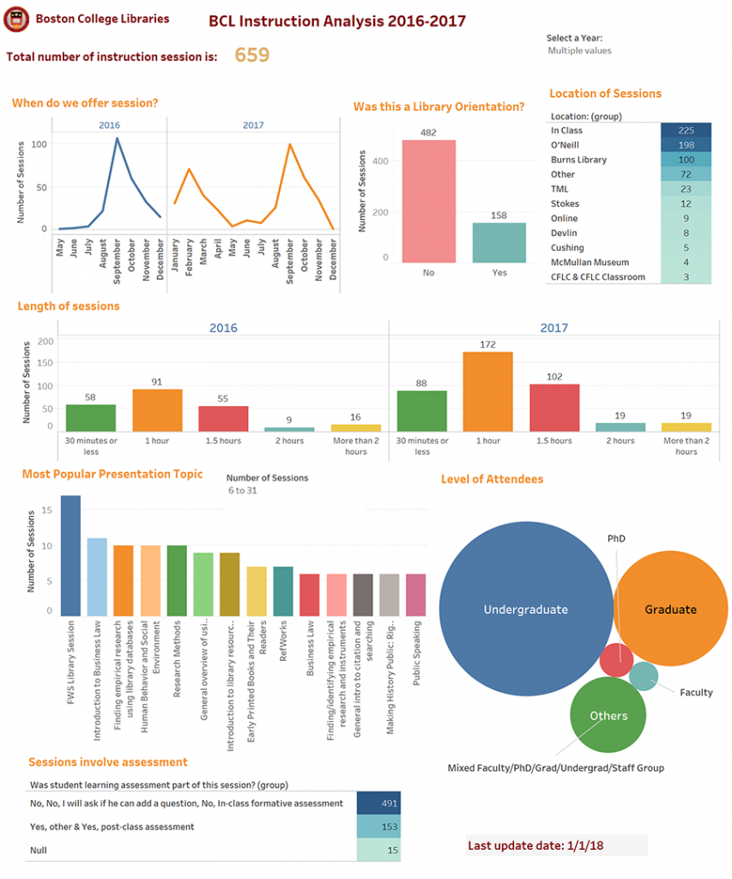
Tableau

Slide 14
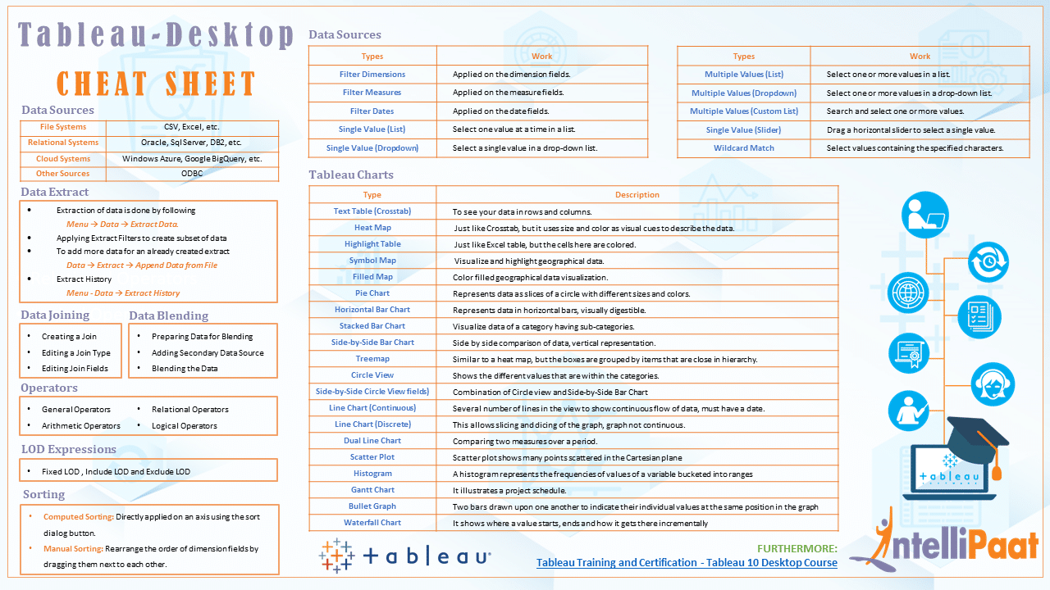

Slide 15
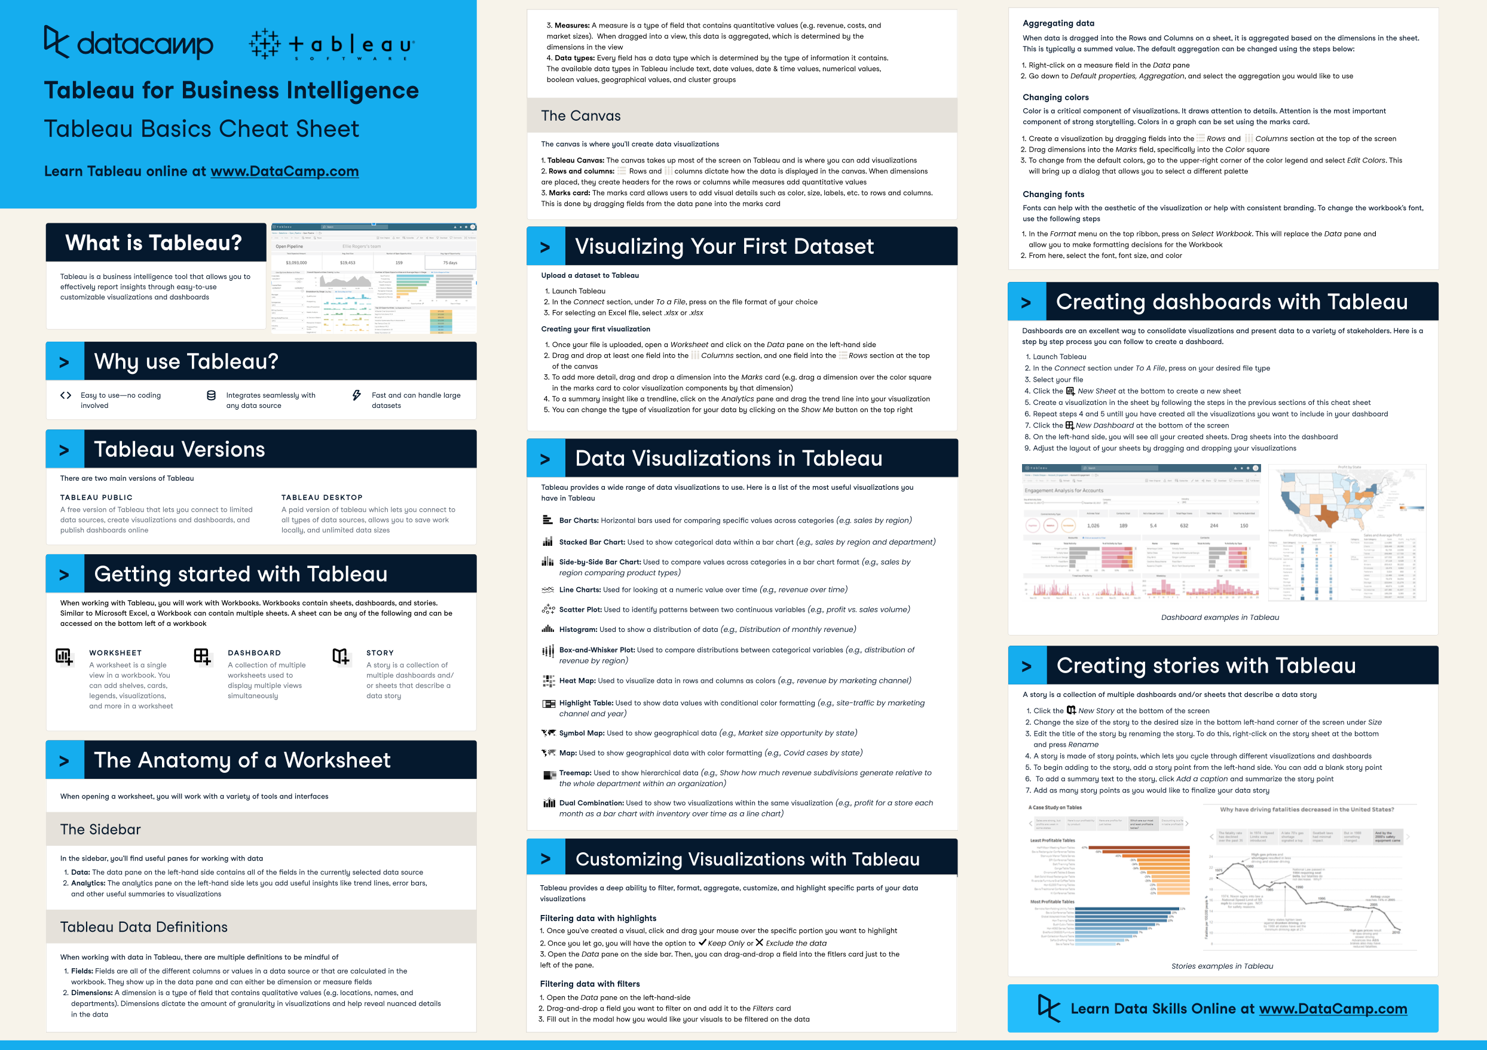

Slide 16
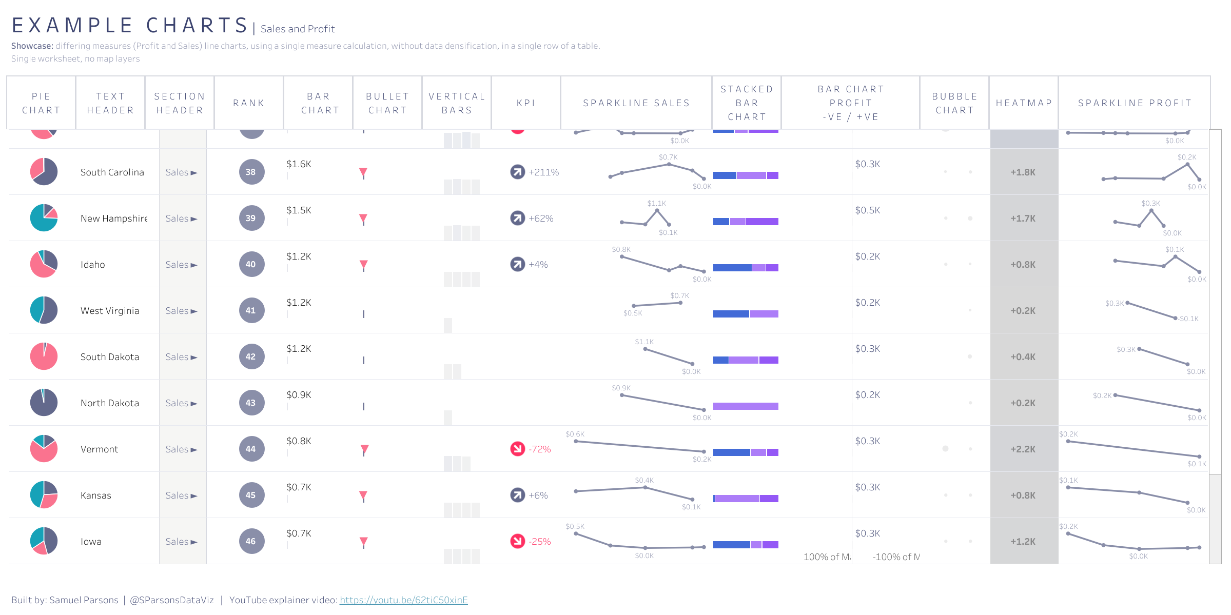

Slide 17
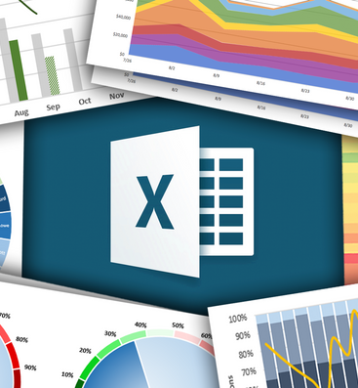
Excel

Slide 18
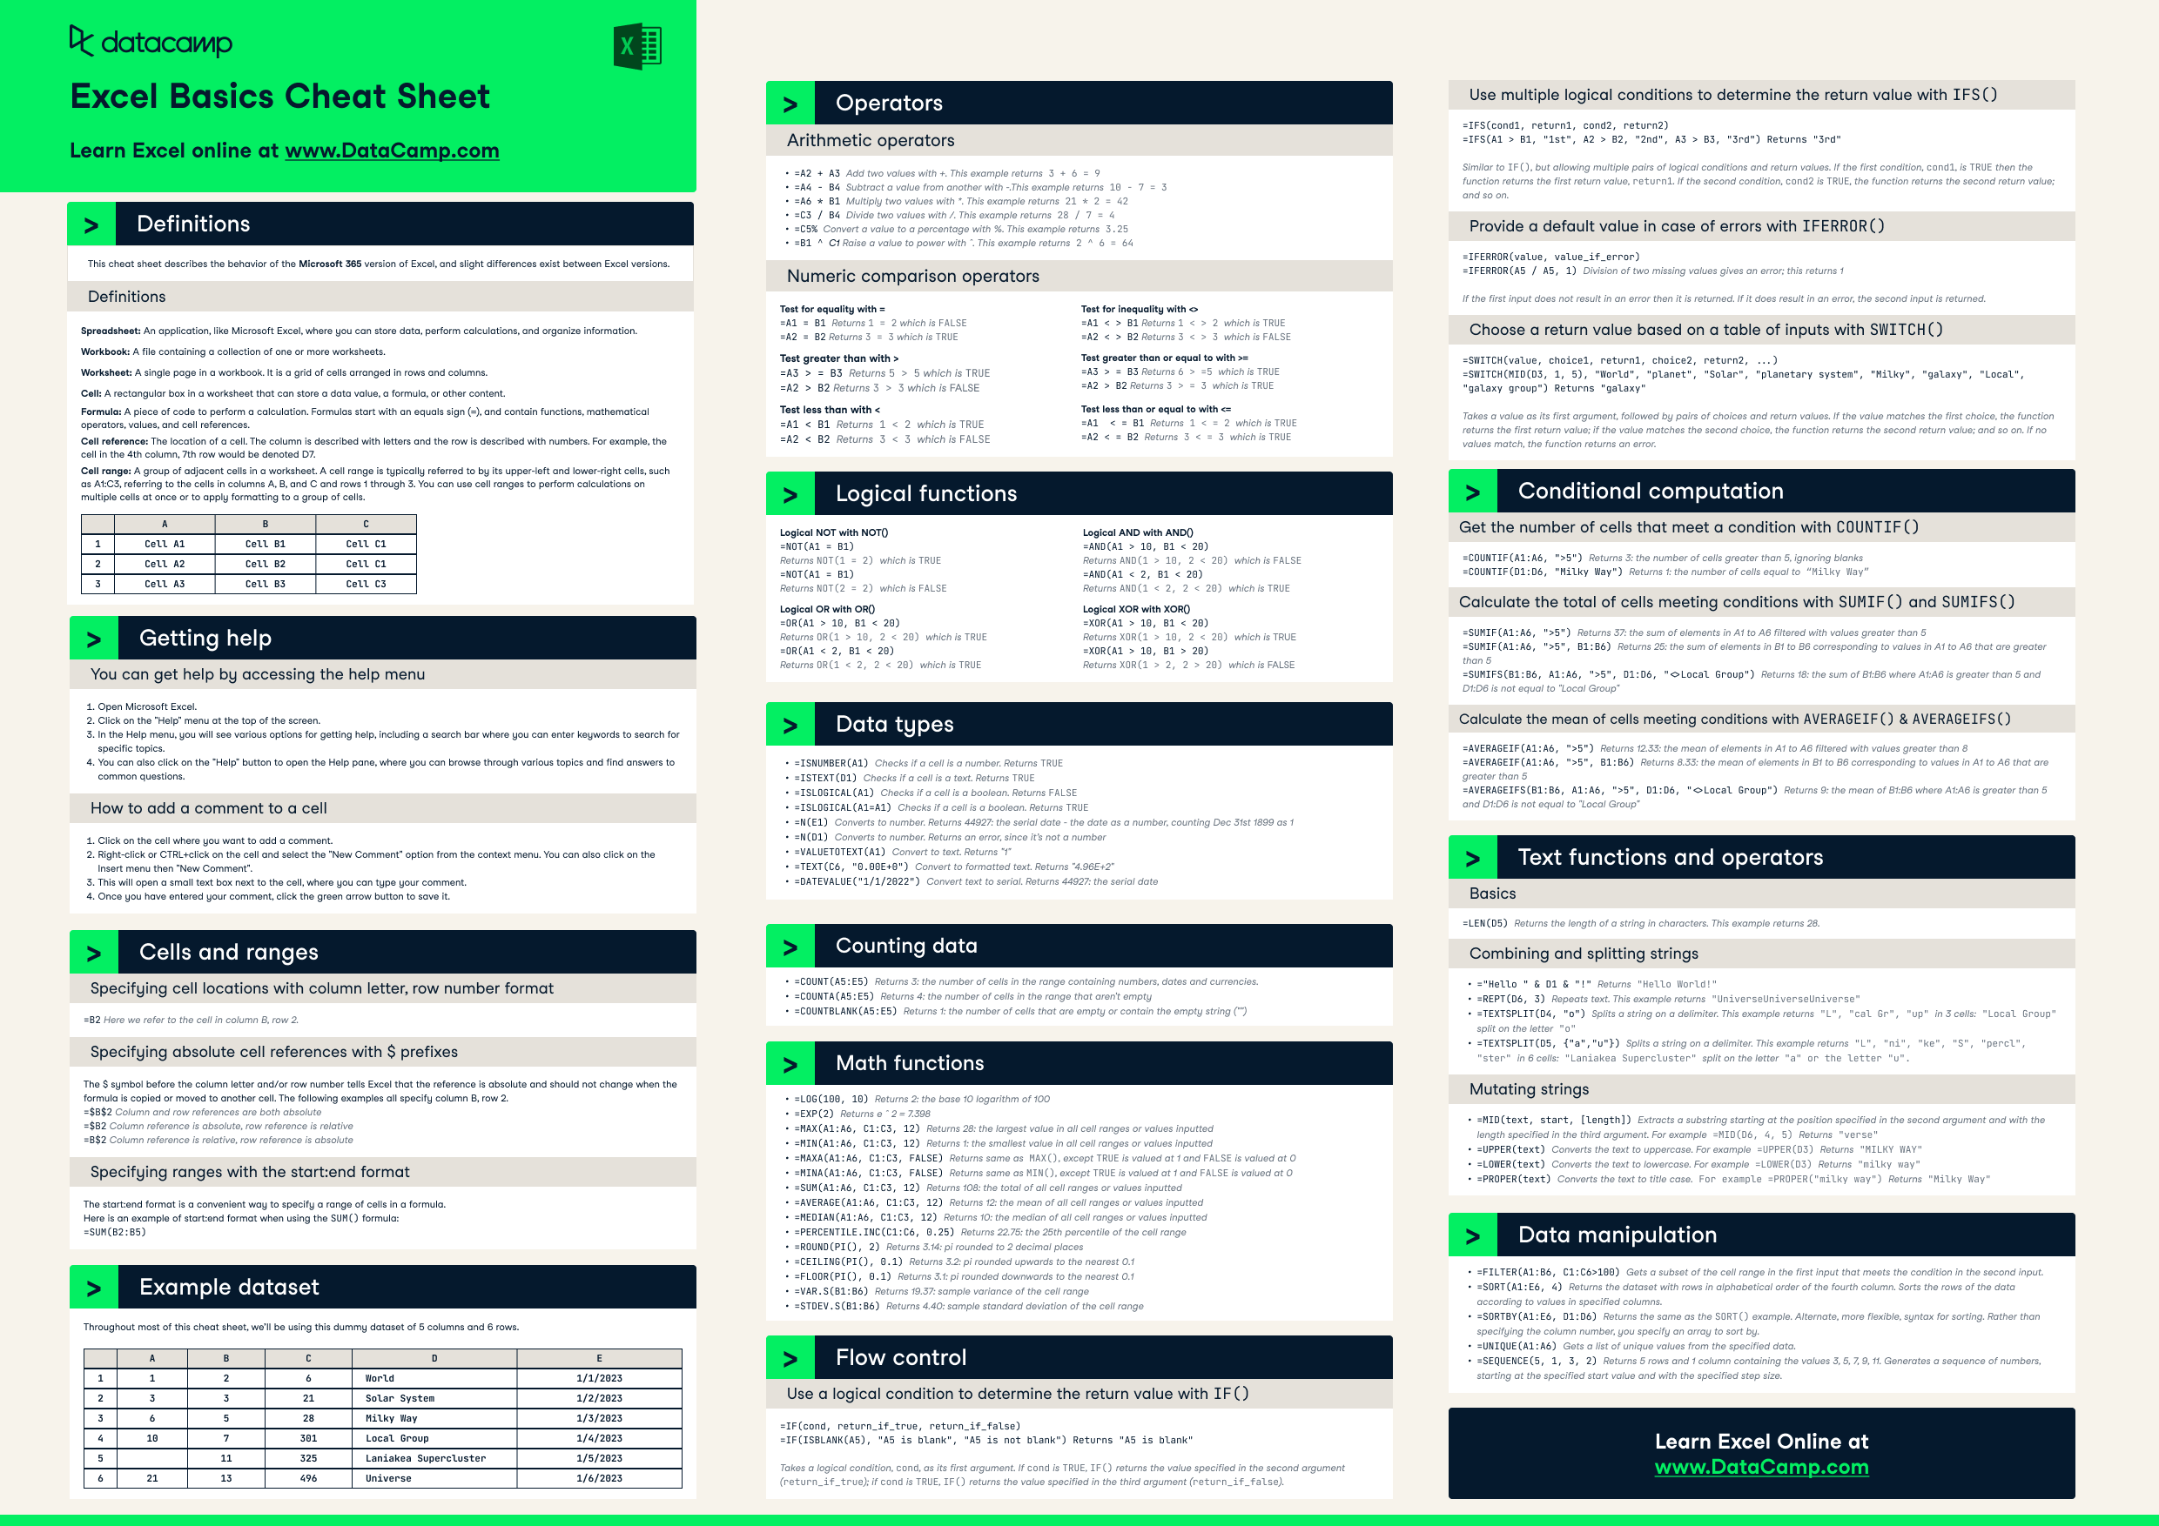

Slide 19
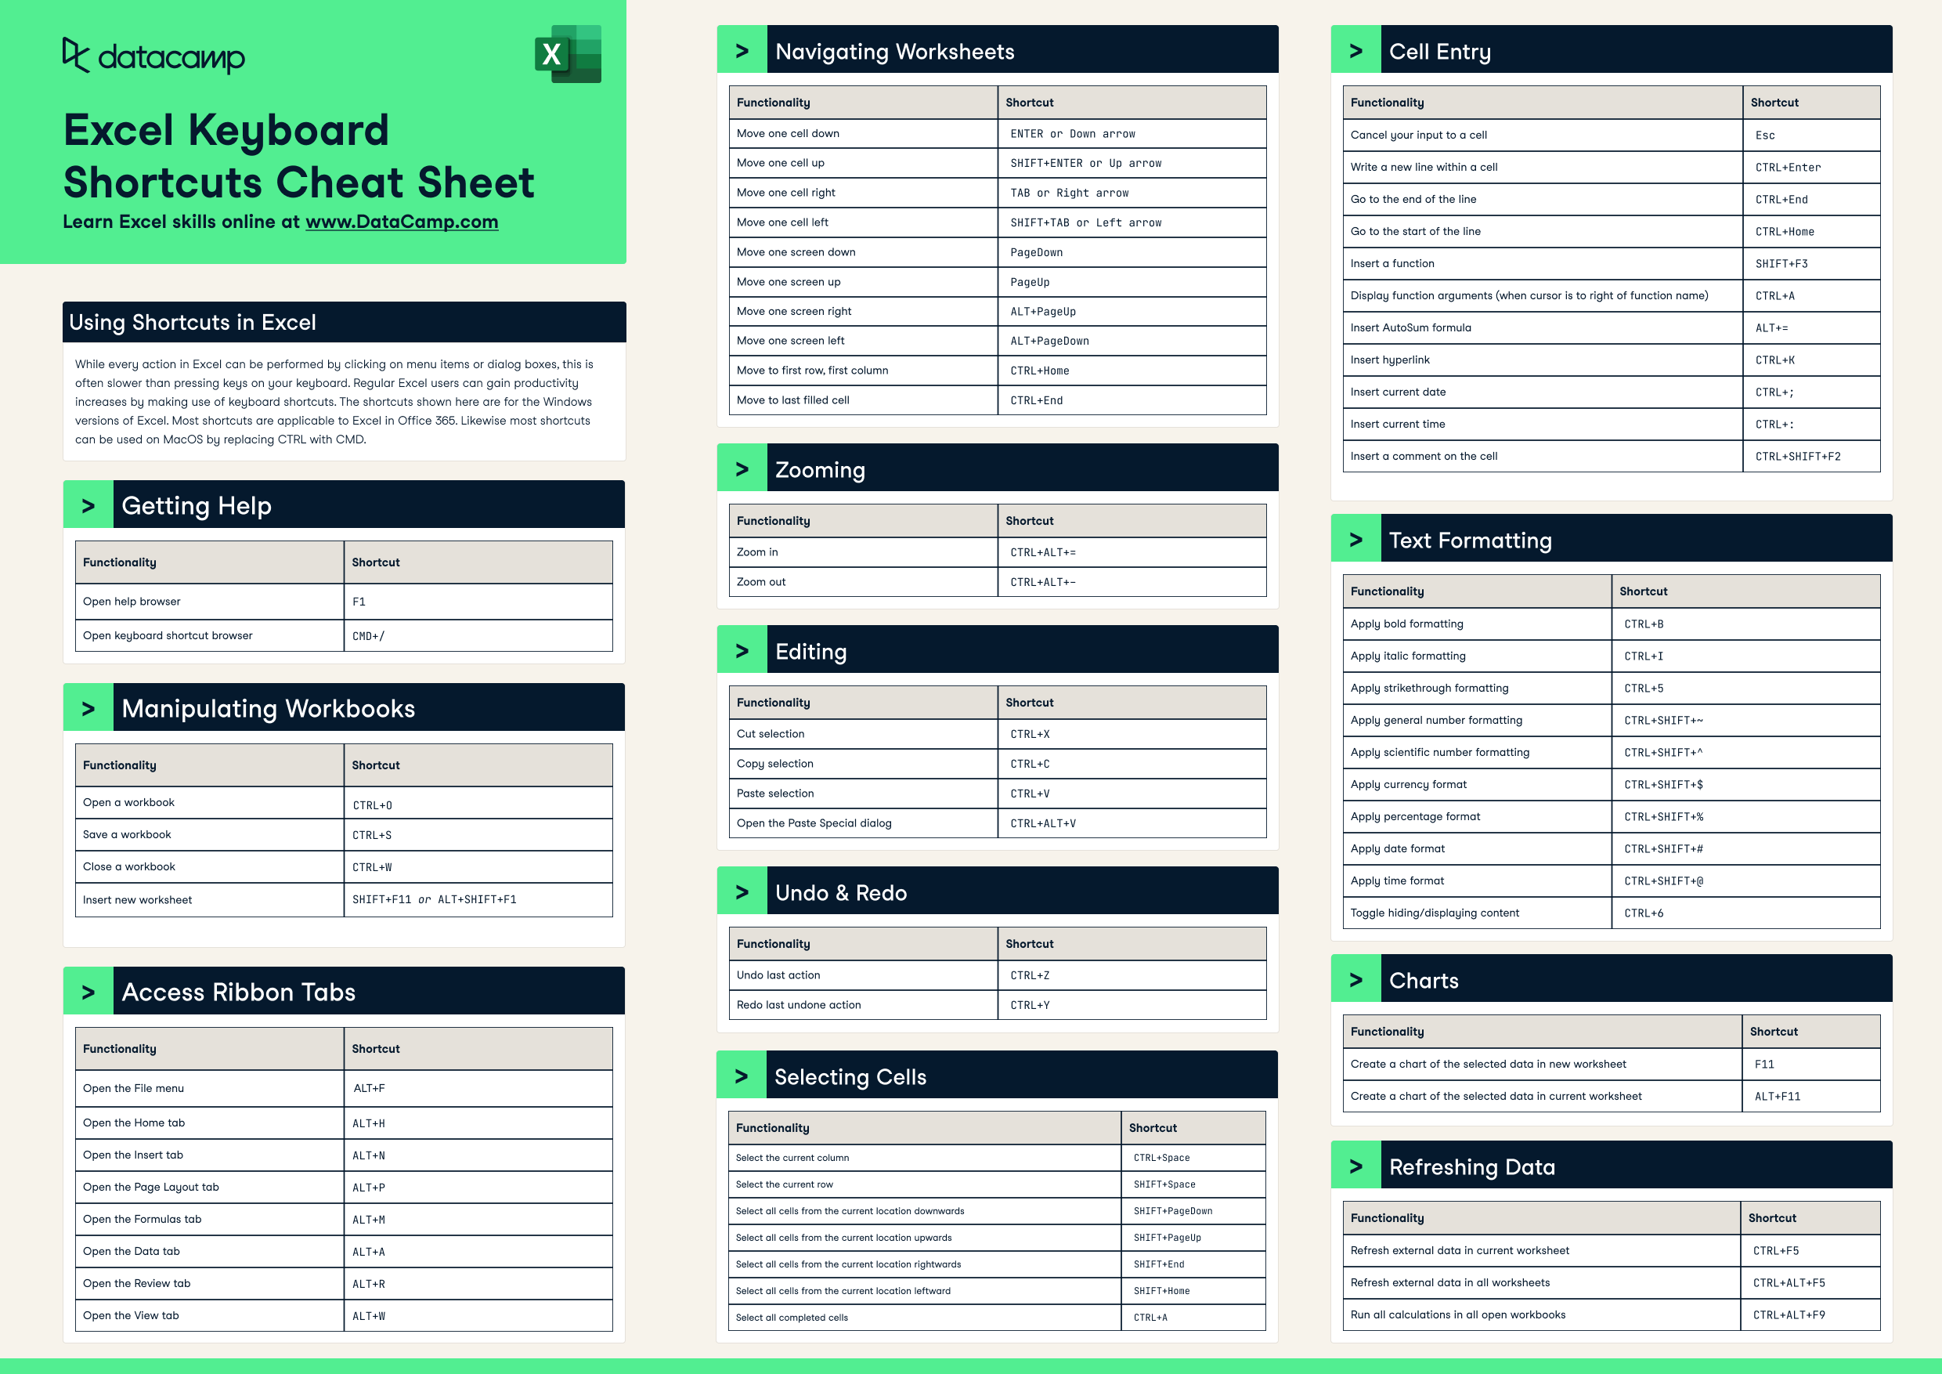

Slide 20
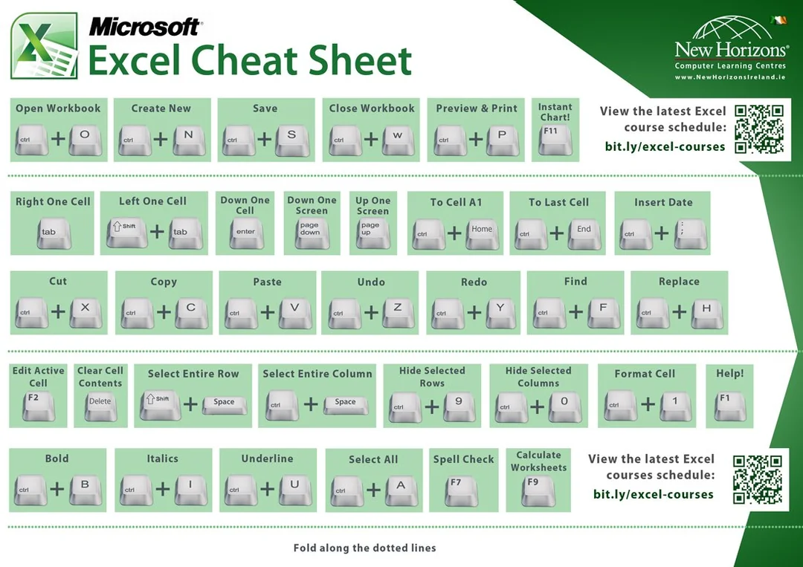

Slide 21
Timeline

Slide 22
Program
Kick-Off
Students will meet their teams and begin planning their project.
4 Workshops
Students will attend guided workshops covering key tools used in data science projects.
Help Sessions
Data@UCI will provide mini help sessions following the end each workshop.
Final Presentations
Groups will have the opportunity to present their projects and win prizes.

Slide 23
Week | Timeline
Week 1 (1/6-1/12) | Regular Event: Info Session for Mentees
Week 2 (1/13 - 1/19) | Regular Event : Project Kick-Off
Week 3 (1/20 - 1/26) | Thursday - Workshop 1: Tour of Notebooks/Environments/IDEs + Help Session
Week 4 (1/27-2/2) | Thursday - Workshop 2: Data Exploration (Pandas & Feature Selection) + Help Session
Week 5 (2/3 - 2/9) | Thursday - Workshop 3: Machine Learning (Scikit-Learn & Model Evaluation) + Help Session
Week 6 (2/10 - 2/16) | Thursday - Collaboration with Design@UCI (tentative + midterms)
Week 7 (2/17 - 2/21) | Thursday - Workshop 4: Data Visualization (Power BI or similar) + Help Session
Week 8 (2/24 - 3/1) | Thursday - Final Winter Project Help Session
Week 9 (3/3 - 3/9) | Thursday - Final Presentations

Slide 24
Deliverables

Slide 25
Week | Deliverable
Week 1 (1/6-1/12) | Commitment
Week 2 (1/13 - 1/19) | Meeting Series
Week 3 (1/20 - 1/26) | Jupyter Notebooks
Week 4 (1/27-2/2) | Exploratory Data Analyses
Week 5 (2/3 - 2/9) | Machine Learning
Week 6 (2/10 - 2/16) | Design
Week 7 (2/17 - 2/21) | Data Visualization
Week 8 (2/24 - 3/1) | Presentation
Week 9 (3/3 - 3/9) | Final Presentation

Slide 26
Thank you!

